Slide 1
Audio Analysis Using Gramian Angular Field (GAF) and FAST
Andrew Fausak, Andy Fausak, Andre Sharp, Mica Haney

Slide 2
Introduction
The premise of this project contains two parts.
First is the generation of Gramian Angular Field (GAF) images based off audio. These GAF images will be re-converted back to their original forms to investigate data loss.
Second is the training of CNN model on both the raw audio data and the GAF images to see if the models learn anything interesting or are comparable to the CNN based on the raw audio data.
The project was conceived because we believed GAF files to be a potentially superior representation format, allowing for better ML learning, data storage, and more.

Slide 3
Dataset
We chose to use the AudioMNIST, which is recordings of people saying digits.
This makes for an easy ML task (classification) with files that aren’t prohibitively large.

Slide 4
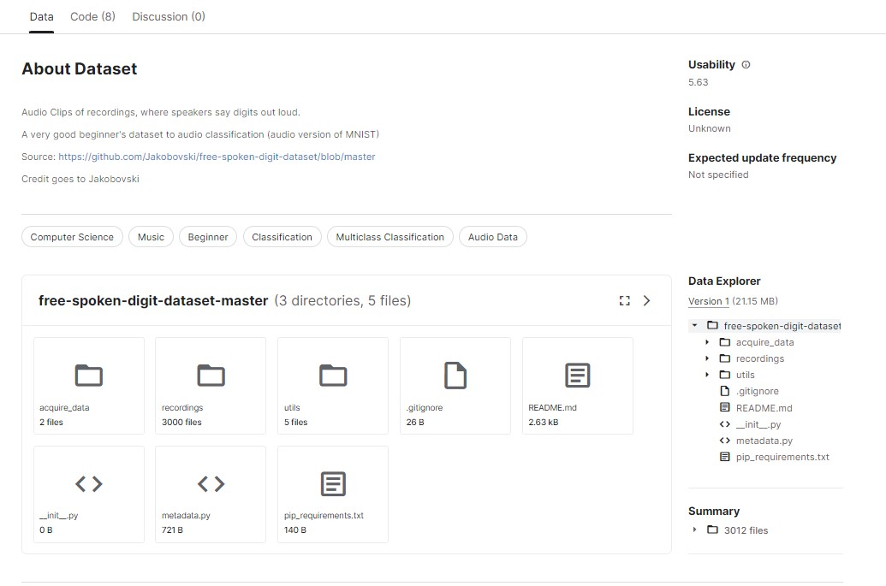
Data: Kaggle
Six individuals speaking, with 50 recordings of each digit per individual.
Total of 3,000 recordings.
This dataset was used to build the initial CNN classifier due to its smaller size, and is not the final dataset.

Slide 5
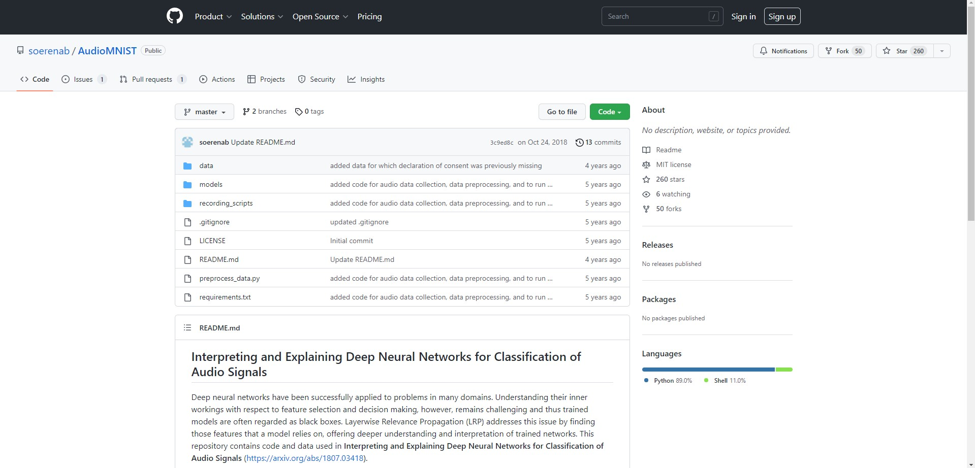
Dataset: GitHub
Sixty individuals speaking, with 50 recordings of each digit being spoken per individual for a total of 30,000 recordings.

Slide 6
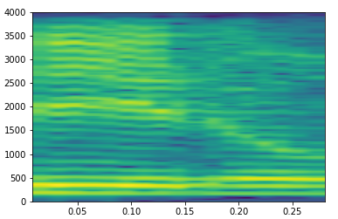
Dataset: Spectrograms
During the initial construction of the CNN classifier, spectrograms of each audio file were generated and trained on.
Due to time constraints, the full CNN classifier did not have a spectrogram experiment. Instead a CNN trained on the raw audio data was used.

Slide 7
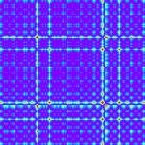
Data: Gramian Angular Fields (GAF)
Both Gramian Angular Summation Fields (GASF) and Gramian Angular Difference Fields (GADF) were generated for each audio file.
GAFs are transformations that represent time and events.

Slide 8
Data: Preprocessing Audio
To use the same model as the other file types, the raw audio data needed some preprocessing.
Sequences were padded to length 48,400. Sequences were then reshaped into 220 x 220 pixel matrices.
Due to negative values within the data, all values were normalized between 0 and 1.

Slide 9
Data: Preprocessing GAF
The initial GAF images (about 6,100 x 6,100 pixels) were too large and caused memory crashes just building the model.
Downsizing the files was necessary. The resulting images were not of consistent sizes. Images that were still too large were discarded. The remaining images were padded (if necessary) to 192 x 192 pixels.

Slide 10
Data: Loading the Files
Due to memory constraints, not all image files could be loaded into memory at once. Instead we used generators to load them in batches of 10.
Tensorflow Datasets were constructed using the generators.
The train/val/test split was 80/10/10, with individual speakers not being allowed to have data in multiple sets.
This slowed training down, but prevented crashing runtimes by filling up all of the memory space.

Slide 11
GAF Generation
Initial GAF Generation
GASF in 8.1khz
GADF in 8.1khz
Second GAF Generation
GASF in 200hz
GADF in 200hz
33,000 audio files

Slide 12
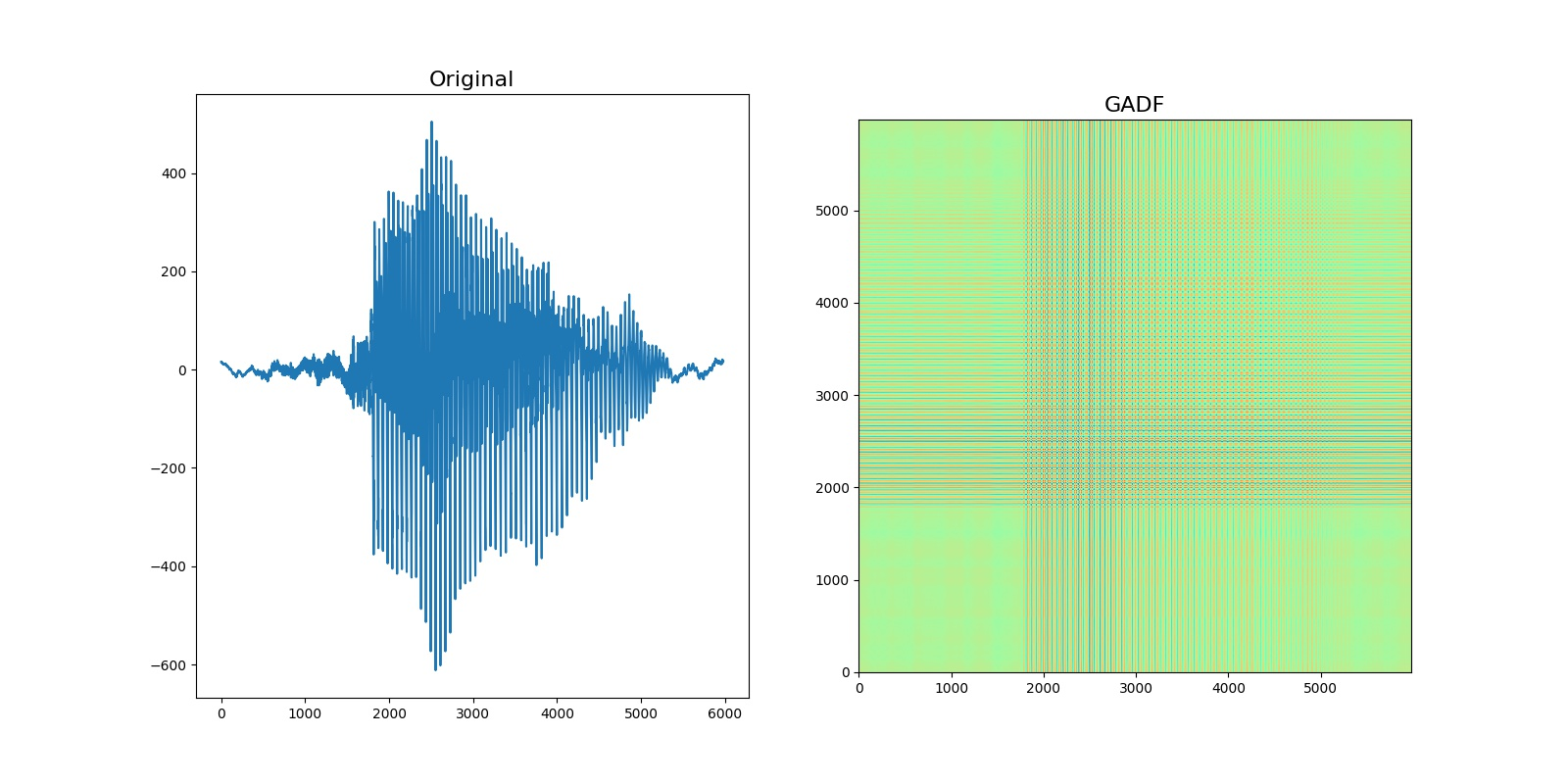
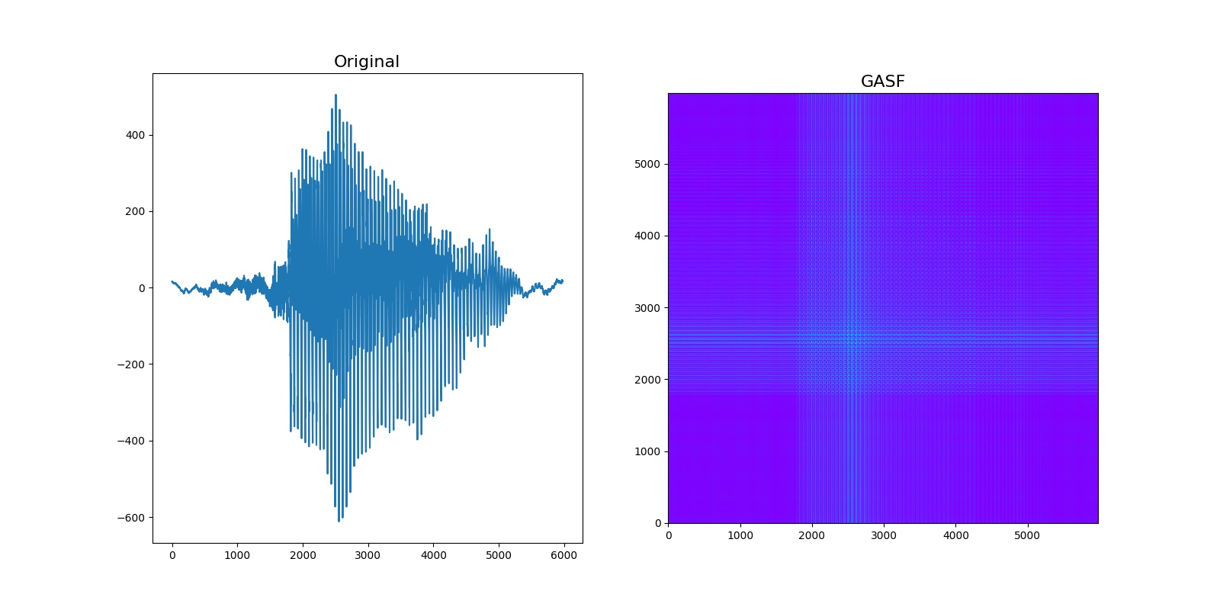
GAF Generation - Gramian Angular Summation Field (GASF)

Slide 13
GAF Generation - Gramian Angular Difference Field (GADF)

Slide 14
GAF Reverse Conversion
GAF Image File
Obtain series of main diagonal
def reconstruct_gaf(number):
return np.arccos(((math.cos(2 * number) + 1) / 2) (1 / 2))

Slide 15
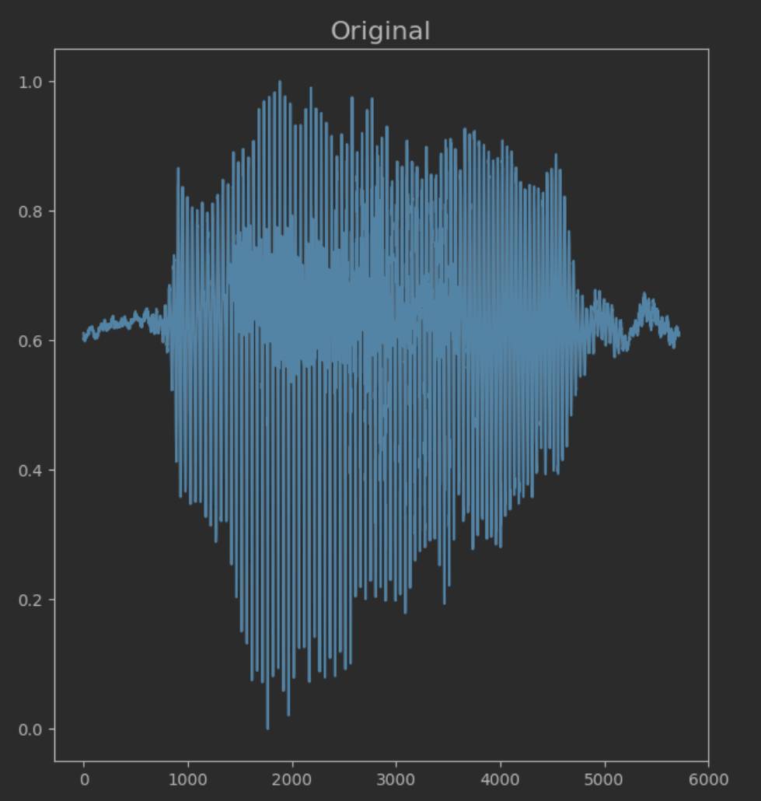
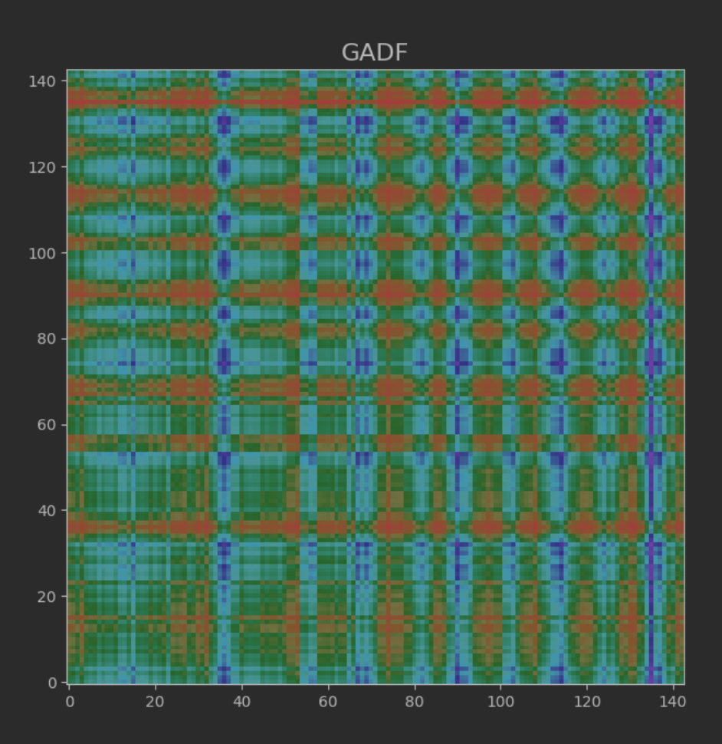
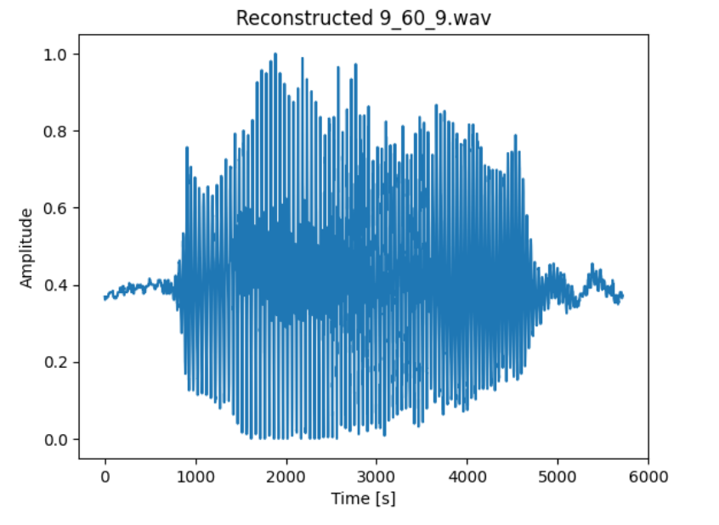
GAF Reverse Conversion

Slide 16
Initial Classifier
The CNN was constructed using the Kaggle dataset for ease of setup and low data memory requirements.
This classifier was trained on the spectrograms generated from the audio files.

Slide 17
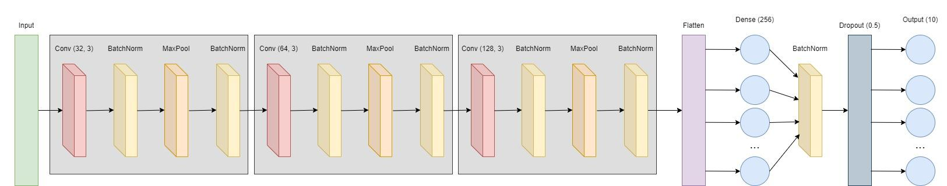
Classifier Architecture

Slide 18
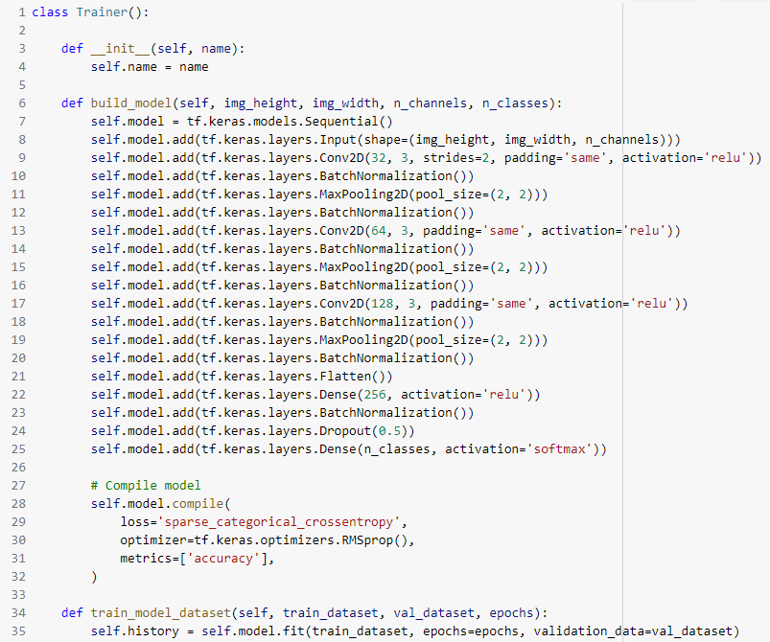
Full Classifier
The full classifier has the same architecture as the initial classifier.
The input shapes changed for each input file type.
The models were trained on the data from the GitHub dataset.

Slide 19
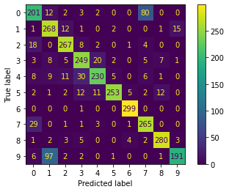
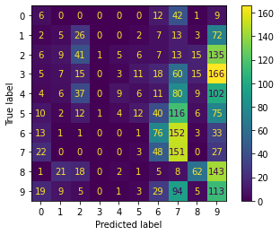
Results: Classifier
The full classifier of the raw data performed decently (top confusion matrix).
The GAF classifiers had poor scores, and tended to massively misclassify.
 | Accuracy | Precision | Recall | F1
Raw Audio | 0.8343 | 0.8445 | 0.8343 | 0.8338
GADF | 0.2021 | 0.2215 | 0.1891 | 0.1590
GASF | 0.2229 | 0.2186 | 0.2061 | 0.1905

Slide 20
Conclusion
More research is needed to find more optimal ways of representing the waveform using GAFs.
Given the poor scores of the GAF-trained classifiers with improvement in the training curves, it is likely that effective models are possible with significantly more training and/or data.
At current though, results indicate that GAFs are not ideal for this purpose, as we had hoped.

Slide 21
References
Shah, S. K., Tariq, Z., Lee, J., & Lee, Y. (2021). Event-Driven Deep Learning for Edge Intelligence (EDL-EI). Sensors, 21(18), 6023.
Wang, Z., & Oates, T. (2015, June). Imaging time-series to improve classification and imputation. In Twenty-Fourth International Joint Conference on Artificial Intelligence.

